Slide 1

The customer-first approach to dealing with jet-lag

Slide 2
When your normal sleep pattern is disturbed after a long flight.
Symptoms usually improve within a few days as your body adjusts to the new time zone.

Slide 3

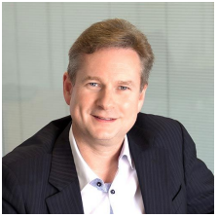
The problem
Jess
Simon
About to go on graduation dream holiday
Had really bad jet-lag last time she travelled
Doesn’t want to lose valuable holiday time
Has to hope, there is information out there - but it is all generic and not easy to find or apply
CEO of Comtec
Understands how negative experiences can stop repeat bookings
Also hates Jet-Lag
Notes:
Both have problems with jet-lag personally and have reasons to eliminate it
For jess jetlag is a barrier to her enjoying her supposedly ‘once in a lifetime holiday’
For simon, being a frequent flyer jet-lag stops him being able to perform his best at business
He also hates jet-lag because he wants his clients customers to buy more package holidays !!

Slide 4
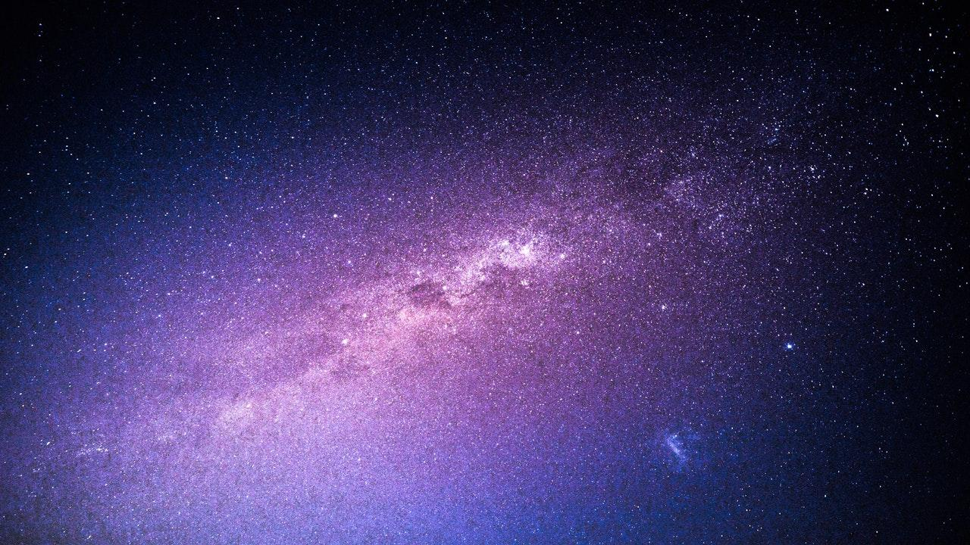

The Solution
Place your screenshot here
Place your screenshot here
A simple, effective companion app that advises on the best strategies and tips to negate jet-lag

Slide 5
How does it work?
Place your screenshot here
Place your screenshot here
Demo Time

Slide 6
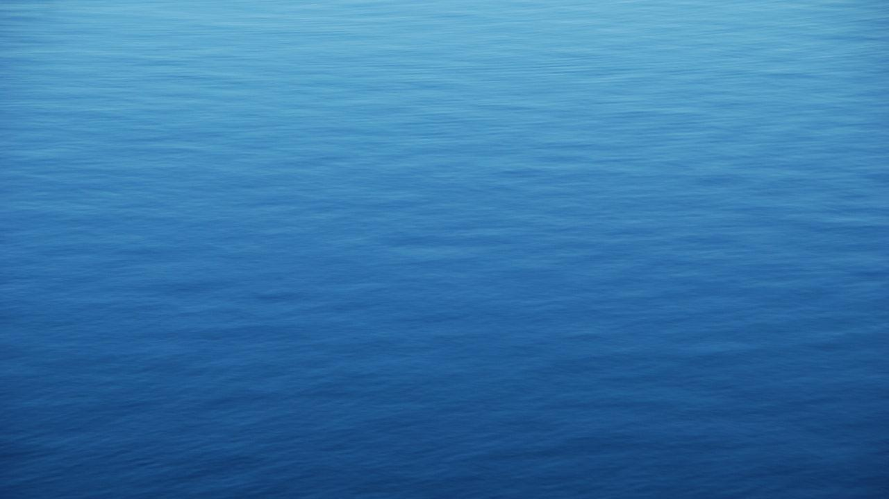
Maps
our office

Slide 7
Why now
Travel agents are expected to be more than people who send people on way?
Dslkfjdslfjdfds
Fdsfdsf
Dsfdsf
The tech is now available and good
Is the color of coal, ebony, and of outer space. It is the darkest color, the result of the absence of or complete absorption of light.

Slide 8
Competition
Lots of apps trying to do the same thing
None of them have the benefit of being integrated directly into Inspiretec’s other offerings however.

Slide 9
Competition
Lots of apps trying to do the same thing
None of them have the benefit of being integrated directly into Inspiretec’s other offerings however.

Slide 10

Hello!
We are here to improve
I am here because I love to give presentations.
You can find me at @username

Slide 11
1.
Transition headline
Let’s start with the first set of slides

Slide 12
Quotations are commonly printed as a means of inspiration and to invoke philosophical thoughts from the reader.

Slide 13
This is a slide title
Here you have a list of items
And some text
But remember not to overload your slides with content
Your audience will listen to you or read the content, but won’t do both.

Slide 14
BIG CONCEPT
STOp t#h#e JET lAg

Slide 15
You can also split your content
White
Is the color of milk and fresh snow, the color produced by the combination of all the colors of the visible spectrum.
Black
Is the color of coal, ebony, and of outer space. It is the darkest color, the result of the absence of or complete absorption of light.

Slide 16
In two or three columns
Yellow
Is the color of gold, butter and ripe lemons. In the spectrum of visible light, yellow is found between green and orange.
Blue
Is the colour of the clear sky and the deep sea. It is located between violet and green on the optical spectrum.
Red
Is the color of blood, and because of this it has historically been associated with sacrifice, danger and courage.

Slide 17
Want big impact?
Use big image.

Slide 18
Use charts to explain your ideas
White
Gray
Black

Slide 19
And tables to compare data
 | A | B | C
Yellow | 10 | 20 | 7
Blue | 30 | 15 | 10
Orange | 5 | 24 | 16

Slide 20
Maps
our office

Slide 21
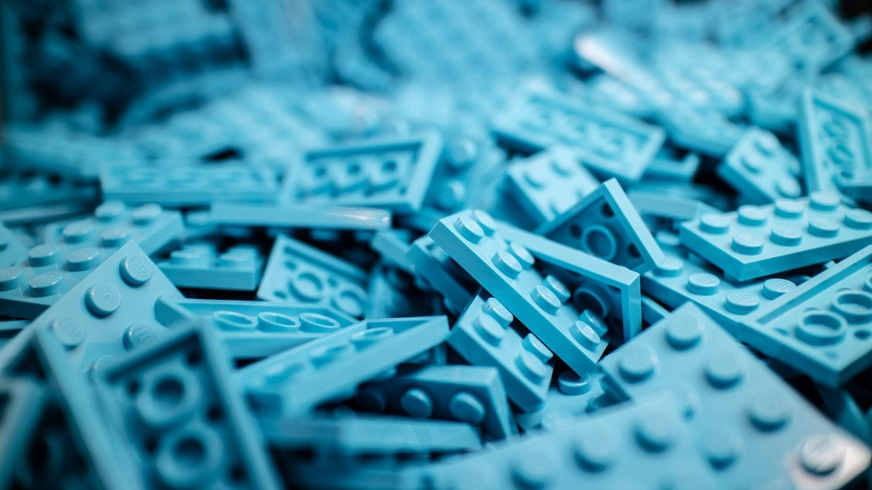
89,526,124
Whoa! That’s a big number, aren’t you proud?

Slide 22
89,526,124$
185,244 users
100%
That’s a lot of money
And a lot of users
Total success!

Slide 23
Our process is easy
first
last
second

Slide 24
Let’s review some concepts
Yellow
Is the color of gold, butter and ripe lemons. In the spectrum of visible light, yellow is found between green and orange.
Blue
Is the colour of the clear sky and the deep sea. It is located between violet and green on the optical spectrum.
Red
Is the color of blood, and because of this it has historically been associated with sacrifice, danger and courage.
Yellow
Is the color of gold, butter and ripe lemons. In the spectrum of visible light, yellow is found between green and orange.
Blue
Is the colour of the clear sky and the deep sea. It is located between violet and green on the optical spectrum.
Red
Is the color of blood, and because of this it has historically been associated with sacrifice, danger and courage.

Slide 25
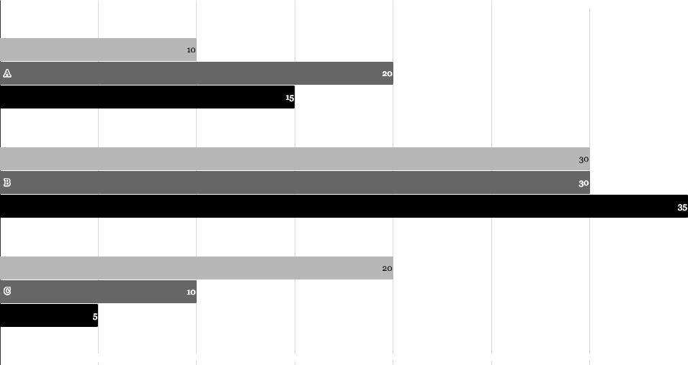
You can insert graphs from Google Sheets

Slide 26
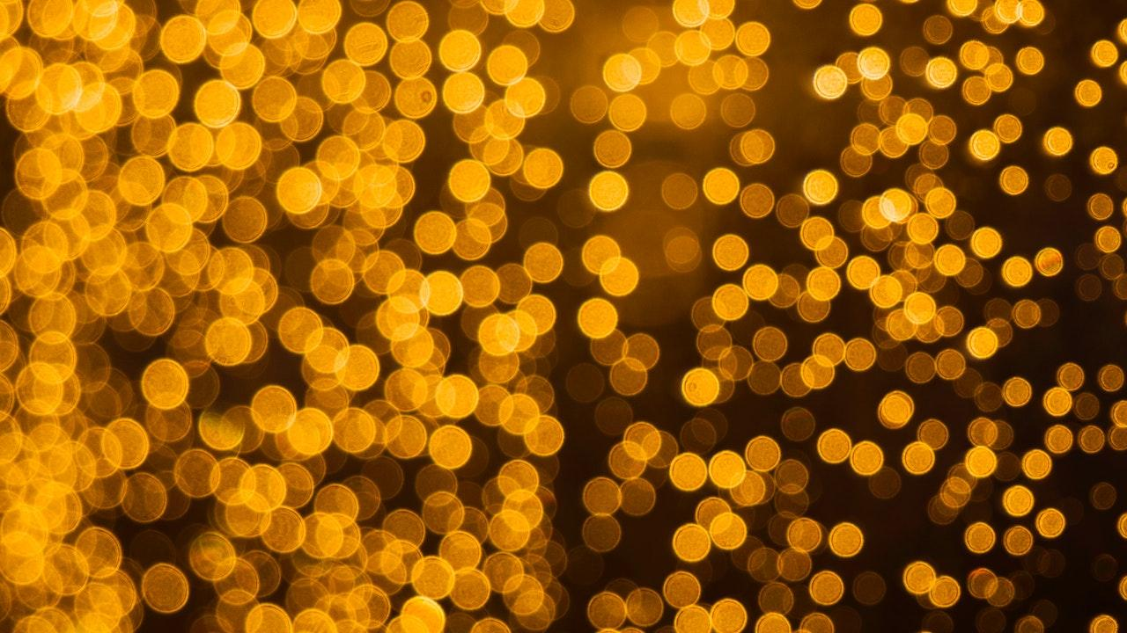
Android project
Place your screenshot here
Show and explain your web, app or software projects using these gadget templates.

Slide 27
iPhone project
Place your screenshot here
Show and explain your web, app or software projects using these gadget templates.

Slide 28
Tablet project
Place your screenshot here
Show and explain your web, app or software projects using these gadget templates.

Slide 29
Desktop project
Place your screenshot here
Show and explain your web, app or software projects using these gadget templates.

Slide 30

Thanks!
Any questions?
You can find me at:
@username
user@mail.me

Slide 31
Credits
Special thanks to all the people who made and released these awesome resources for free:
Presentation template by SlidesCarnival
Photographs by Unsplash

Slide 32
Presentation design
This presentation uses the following typographies:
Titles: Playfair Display
Body copy: Raleway light
You can download the fonts on these pages:
https://www.fontsquirrel.com/fonts/playfair-display
https://www.fontsquirrel.com/fonts/raleway
You don’t need to keep this slide in your presentation. It’s only here to serve you as a design guide if you need to create new slides or download the fonts to edit the presentation in PowerPoint®

Slide 33
SlidesCarnival icons are editable shapes.
This means that you can:
Resize them without losing quality.
Change line color, width and style.
Isn’t that nice? :)
Examples:

Slide 34
😉
Now you can use any emoji as an icon!
And of course it resizes without losing quality and you can change the color.
How? Follow Google instructions https://twitter.com/googledocs/status/730087240156643328
✋👆👉👍👤👦👧👨👩👪💃🏃💑❤😂😉😋😒😭👶😸🐟🍒🍔💣📌📖🔨🎃🎈🎨🏈🏰🌏🔌🔑 and many more...

